Slide 1
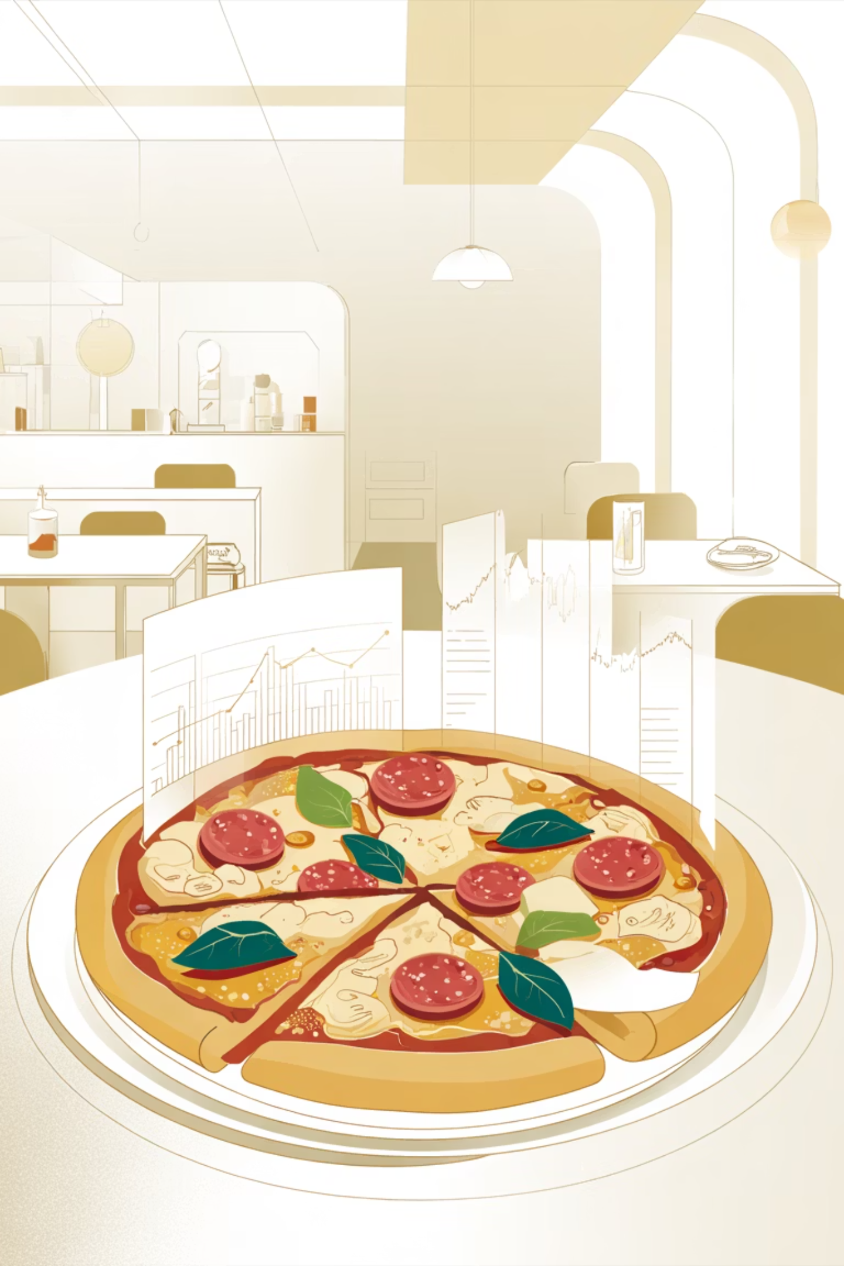
Pizza Sales Analytics
SQL-powered insights into revenue, orders, and performance metrics

Slide 2
Key Performance Indicators
$817.9K
$38.31
49,574
21,350
Total Revenue
Average Order Value
Total Pizzas Sold
Total Orders
Overall sales performance
Per transaction spending
Units moved
Customer transactions
2.32
Pizzas Per Order
Average order size

Slide 3
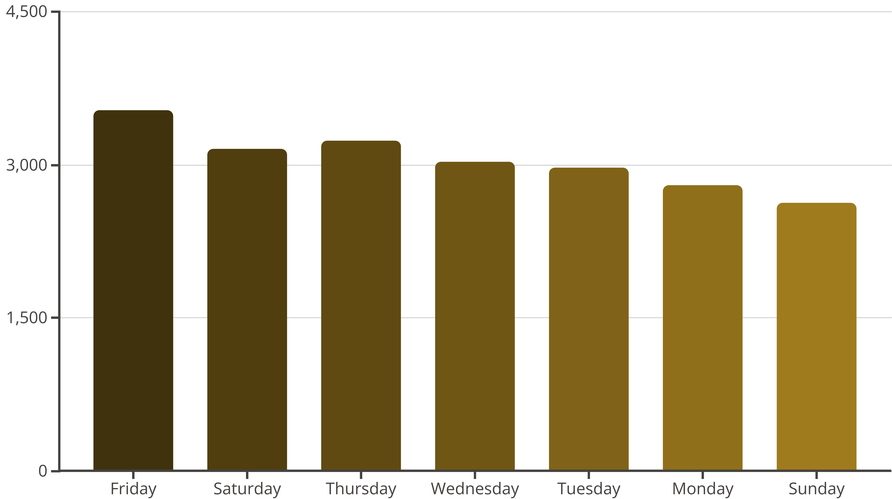
Daily Order Trends
Peak ordering patterns by day of week
Friday and Saturday drive highest order volumes

Slide 4
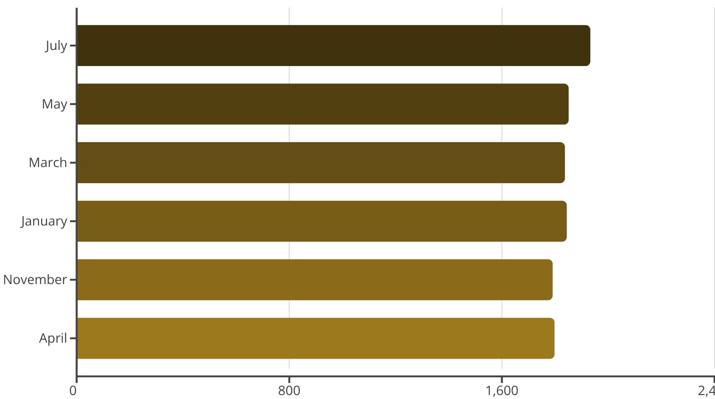
Monthly Performance
Seasonal Insights
July leads with 1,935 orders
Spring and summer months show strongest performance
Strategic planning opportunities for slower months

Slide 5
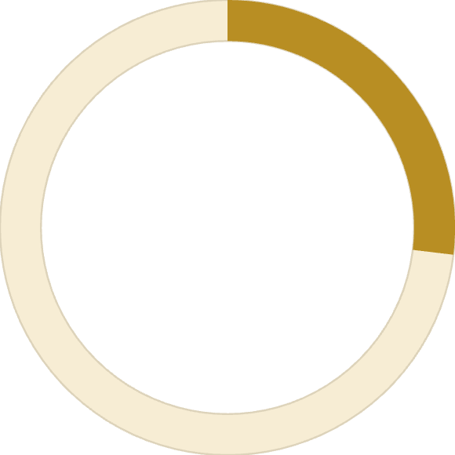
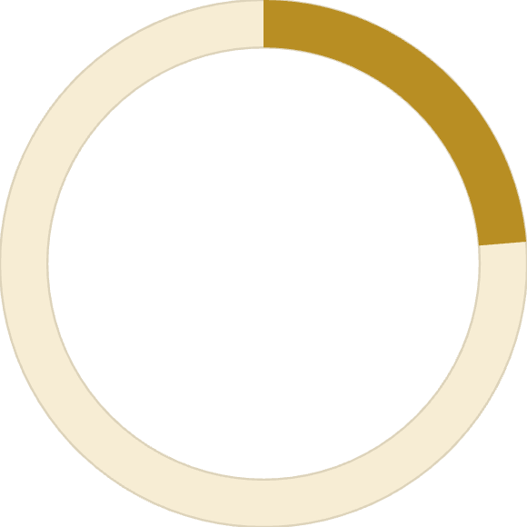


Sales by Category
26.91%
23.68%
Classic
Supreme
Traditional favorites
Premium options
23.96%
25.46%
Chicken
Veggie
Poultry-based pizzas
Plant-based choices
Balanced distribution across all categories with Classic leading

Slide 6
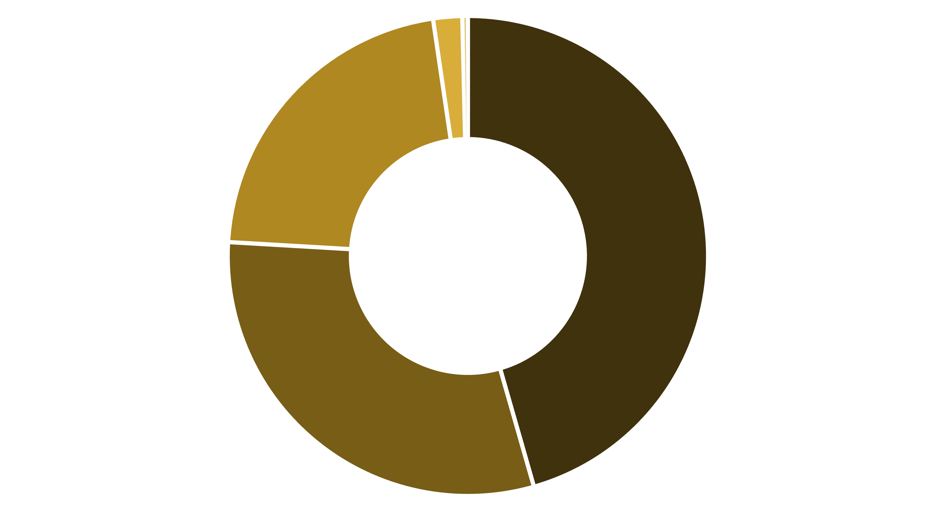
Size Matters
Revenue distribution by pizza size
Large
Medium
Regular
X-Large
XX-Large
Large pizzas dominate revenue at 45.89%

Slide 7
Top Revenue Performers
🏆 Thai Chicken
🥈 Barbecue Chicken
🥉 California Chicken
$43,434 revenue leader
$42,768 strong second
$41,410 top three
Classic Deluxe
Spicy Italian
$38,181 classic choice
$34,831 heat seeker

Slide 8

Underperformers
Bottom 5 by Revenue
Bottom 5 by Quantity
Brie Carre: $11,588
Brie Carre: 490 units
Mediterranean: $15,361
Mediterranean: 934 units
Calabrese: $15,735
Calabrese: 937 units
Spinach Supreme: $15,278
Spinach Supreme: 950 units
Soppressata: $15,598
Soppressata: 961 units
Consider menu optimization or promotional strategies for low performers

Slide 9
Order Volume Champions
01
02
03
Classic Deluxe
Barbecue Chicken
Hawaiian
2,453 orders - consistent favorite
2,432 orders - crowd pleaser
2,422 orders - tropical twist
04
05
Pepperoni
Thai Chicken
2,418 orders - timeless classic
2,371 orders - exotic appeal

Slide 10
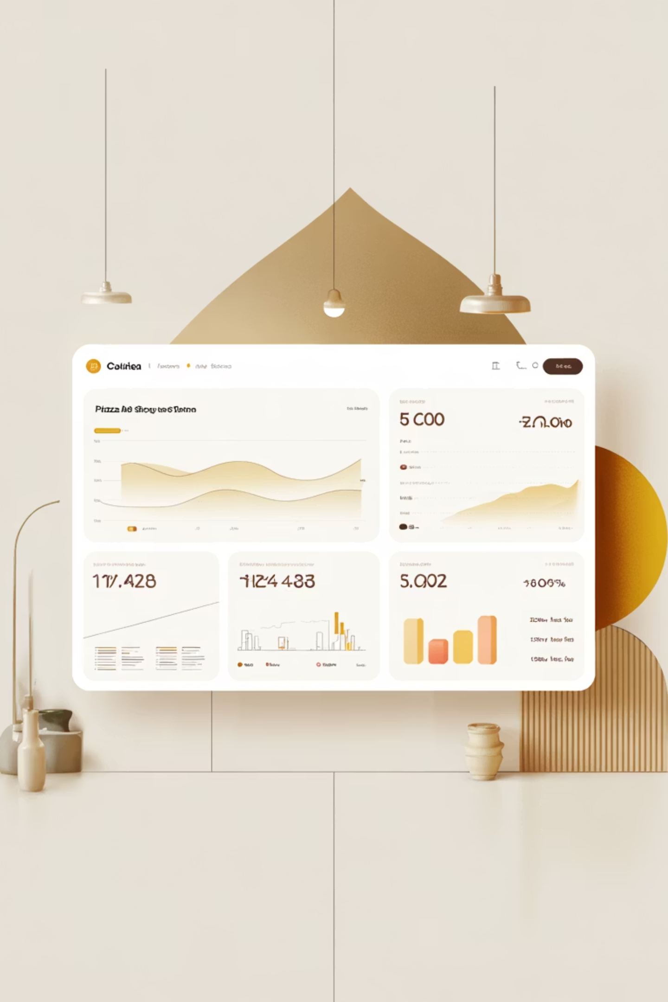
Key Takeaways
Strong Overall Performance
$817.9K revenue across 21,350 orders demonstrates solid market presence
Weekend Dominance
Friday and Saturday peak ordering patterns guide staffing and inventory
Size Strategy
Large pizzas drive 46% of revenue - optimize pricing and promotions
Menu Optimization
Focus on top performers while evaluating underperforming specialty items

